Slide 1
JAVA BOOTCAMP DAY 18
Presented by
G2Academy

Slide 2
SPRING BOOT
Notes:
How presentation will benefit audience: Adult learners are more interested in a subject if they know how or why it is important to them.
Presenter’s level of expertise in the subject: Briefly state your credentials in this area, or explain why participants should listen to you.

Slide 3
Introduction
Spring Boot is an open source Java-based framework used to create a micro Service. It is developed by Pivotal Team and is used to build stand-alone and production ready spring applications. This chapter will give you an introduction to Spring Boot and familiarizes you with its basic concepts.
Notes:
Lesson descriptions should be brief.

Slide 4
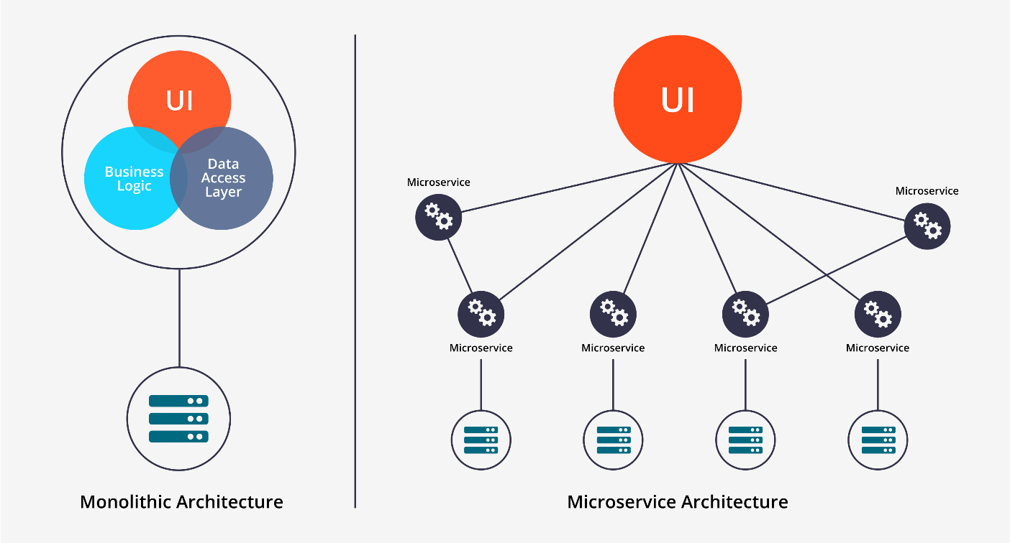
What is Micro Service?
Micro Service is an architecture that allows the developers to develop and deploy services independently. Each service running has its own process and this achieves the lightweight model to support business applications.
Notes:
Lesson descriptions should be brief.

Slide 5
Advantages
Micro services offers the following advantages to its developers −
Easy deployment
Simple scalability
Compatible with Containers
Minimum configuration
Lesser production time
Notes:
Lesson descriptions should be brief.

Slide 6
What is Spring Boot?
Spring Boot provides a good platform for Java developers to develop a stand-alone and production-grade spring application that you can just run. You can get started with minimum configurations without the need for an entire Spring configuration setup.
Spring Boot offers the following advantages to its developers −
Easy to understand and develop spring applications
Increases productivity
Reduces the development time
Spring Boot is designed with the following goals −
To avoid complex XML configuration in Spring
To develop a production ready Spring applications in an easier way
To reduce the development time and run the application independently
Offer an easier way of getting started with the application
Notes:
Lesson descriptions should be brief.

Slide 7
Why Spring Boot?
You can choose Spring Boot because of the features and benefits it offers as given here −
It provides a flexible way to configure Java Beans, XML configurations, and Database Transactions.
It provides a powerful batch processing and manages REST endpoints.
In Spring Boot, everything is auto configured; no manual configurations are needed.
It offers annotation-based spring application
Eases dependency management
It includes Embedded Servlet Container
Notes:
Lesson descriptions should be brief.

Slide 8
How does it work?
Spring Boot automatically configures your application based on the dependencies you have added to the project by using @EnableAutoConfiguration annotation. For example, if MySQL database is on your classpath, but you have not configured any database connection, then Spring Boot auto-configures an in-memory database.
The entry point of the spring boot application is the class contains @SpringBootApplication annotation and the main method.
Spring Boot automatically scans all the components included in the project by using @ComponentScan annotation.
Notes:
Lesson descriptions should be brief.

Slide 9
Spring Boot Starters
Handling dependency management is a difficult task for big projects. Spring Boot resolves this problem by providing a set of dependencies for developers convenience.
For example, if you want to use Spring and JPA for database access, it is sufficient if you include spring-boot-starter-data-jpa dependency in your project.
Note that all Spring Boot starters follow the same naming pattern spring-boot-starter- *, where * indicates that it is a type of the application.
Notes:
Lesson descriptions should be brief.

Slide 10
Examples
Spring Boot Starter Actuator dependency is used to monitor and manage your application. Its code is shown below −
<dependency>
<groupId>org.springframework.boot</groupId>
<artifactId>spring-boot-starter-actuator</artifactId>
</dependency>
Spring Boot Starter Security dependency is used for Spring Security. Its code is shown below −
<dependency>
<groupId>org.springframework.boot</groupId>
<artifactId>spring-boot-starter-security</artifactId>
</dependency>
Notes:
Lesson descriptions should be brief.

Slide 11
Examples
Spring Boot Starter web dependency is used to write a Rest Endpoints. Its code is shown below −
<dependency>
<groupId>org.springframework.boot</groupId>
<artifactId>spring-boot-starter-web</artifactId>
</dependency>
Spring Boot Starter Thyme Leaf dependency is used to create a web application. Its code is shown below −
<dependency>
<groupId>org.springframework.boot</groupId>
<artifactId>spring-boot-starter-thymeleaf</artifactId>
</dependency>
Notes:
Lesson descriptions should be brief.

Slide 12
Examples
Spring Boot Starter Test dependency is used for writing Test cases. Its code is shown below −
<dependency>
<groupId>org.springframework.boot</groupId>
<artifactId>spring-boot-starter-test<artifactId>
</dependency>
Notes:
Lesson descriptions should be brief.

Slide 13
Auto Configuration
Spring Boot Auto Configuration automatically configures your Spring application based on the JAR dependencies you added in the project. For example, if MySQL database is on your class path, but you have not configured any database connection, then Spring Boot auto configures an in-memory database.
For this purpose, you need to add @EnableAutoConfiguration annotation or @SpringBootApplication annotation to your main class file. Then, your Spring Boot application will be automatically configured.
Notes:
Lesson descriptions should be brief.

Slide 14
Auto Configuration
Observe the following code for a better understanding −
import org.springframework.boot.SpringApplication;
import org.springframework.boot.autoconfigure.EnableAutoConfiguration;
@EnableAutoConfiguration
public class DemoApplication {
public static void main(String[] args) {
SpringApplication.run(DemoApplication.class, args);
}
}
Notes:
Lesson descriptions should be brief.

Slide 15
Spring Boot Application
The entry point of the Spring Boot Application is the class contains @SpringBootApplication annotation. This class should have the main method to run the Spring Boot application. @SpringBootApplication annotation includes Auto- Configuration, Component Scan, and Spring Boot Configuration.
If you added @SpringBootApplication annotation to the class, you do not need to add the @EnableAutoConfiguration, @ComponentScan and @SpringBootConfiguration annotation. The @SpringBootApplication annotation includes all other annotations.
Notes:
Lesson descriptions should be brief.

Slide 16
Spring Boot Application
Observe the following code for a better understanding −
import org.springframework.boot.SpringApplication;
import org.springframework.boot.autoconfigure.SpringBootApplication;
@SpringBootApplication
public class DemoApplication {
public static void main(String[] args) {
SpringApplication.run(DemoApplication.class, args);
}
}
Notes:
Lesson descriptions should be brief.

Slide 17
Component Scan
Spring Boot application scans all the beans and package declarations when the application initializes. You need to add the @ComponentScan annotation for your class file to scan your components added in your project.
Observe the following code for a better understanding −
import org.springframework.boot.SpringApplication;
import org.springframework.context.annotation.ComponentScan;
@ComponentScan
public class DemoApplication {
public static void main(String[] args) {
SpringApplication.run(DemoApplication.class, args);
}
}
Notes:
Lesson descriptions should be brief.

Slide 18
Requirements
Java JDK 8 or higher
Good Internet Connection for downloading Depedencies
Notes:
Lesson descriptions should be brief.

Slide 19
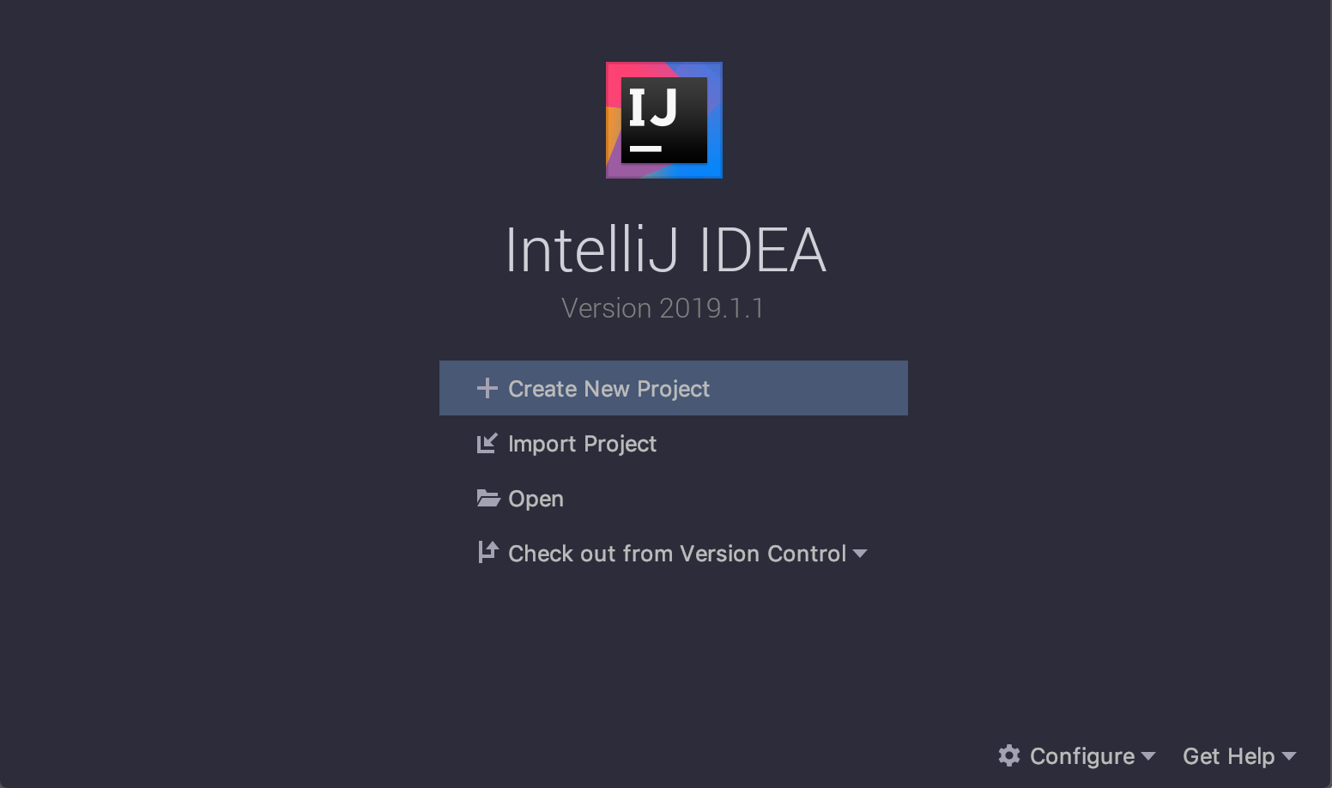
Creating the project
As soon as it starts, you’ll see the following screen:
Notes:
Lesson descriptions should be brief.

Slide 20
Creating the project
For this example, we’ll be using Maven as build-tool.
Unfortunately using IntelliJ IDEA Community, according to the documentation, there’s no support to create Spring Boot projects using Spring Initializr through the IDE in Community version, only in the Ultimate Edition. So, we have two choices that we can explore:
Notes:
Lesson descriptions should be brief.

Slide 21
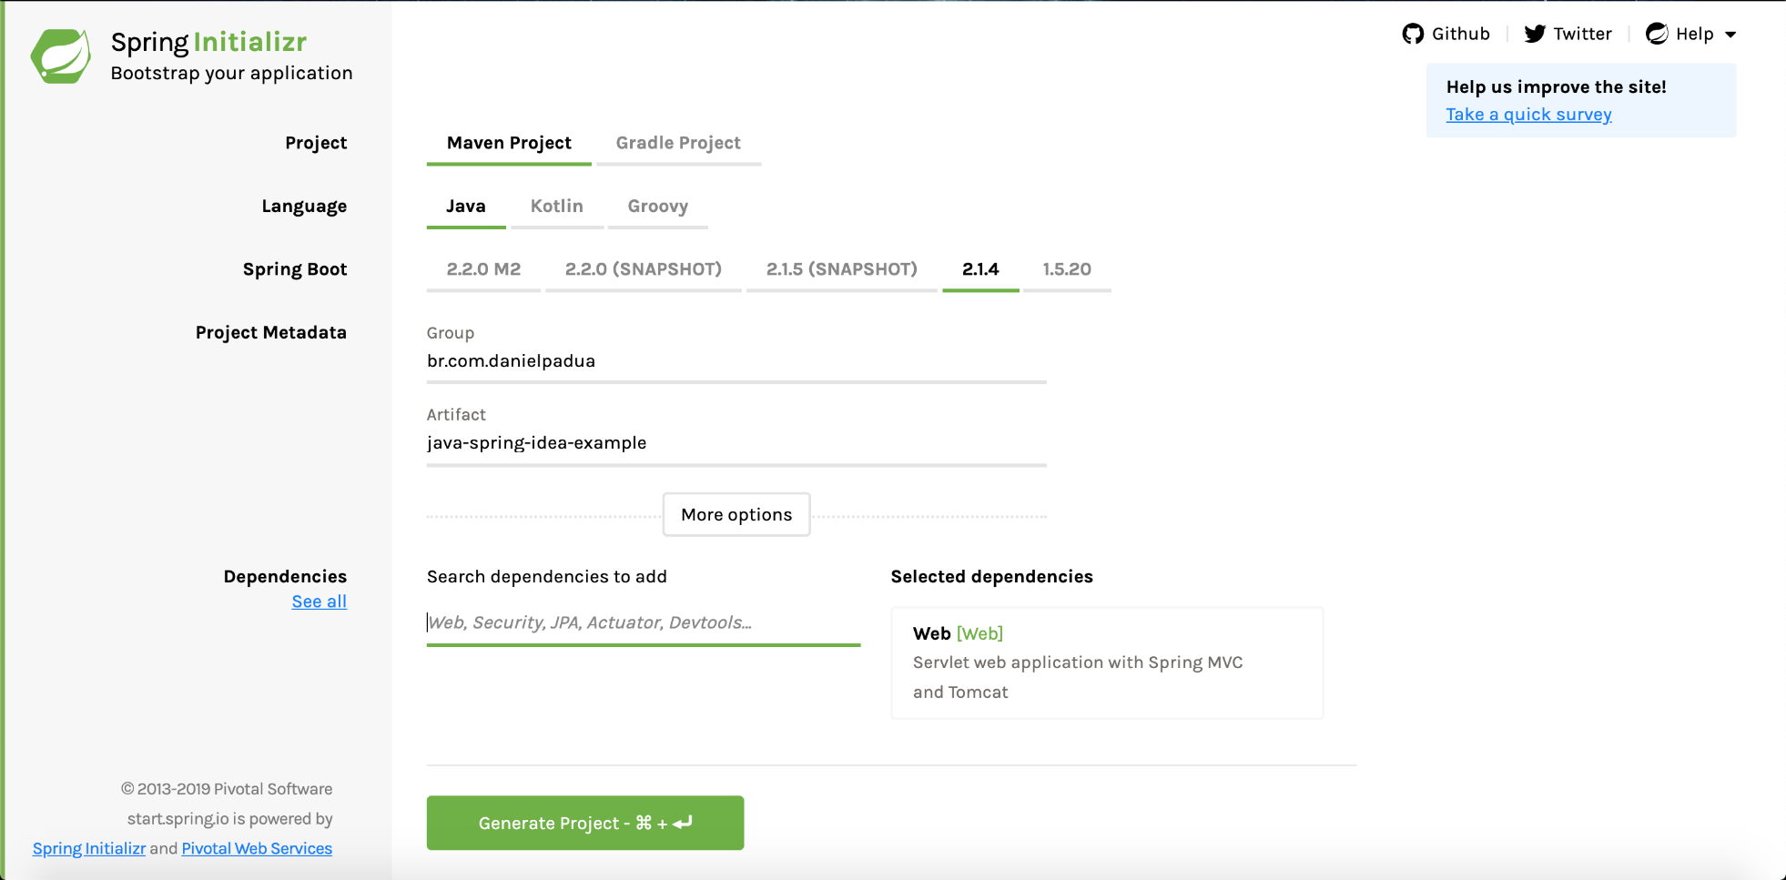
1st Way : Use Spring Initializr Web
Access: https://start.spring.io, and fill the fields like below:
Notes:
Lesson descriptions should be brief.

Slide 22
1st Way : Use Spring Initializr Web
Don’t forget to select Web as dependency. Click Generate Project to download the project zip file.
Extract it to a directory of your choice, go back to IntelliJ IDEA and select Import Project.
Navigate to project’s directory and select the pom.xml file.
You’ll see a window that is responsible for importing the Maven project, leave the defaults configs:
Notes:
Lesson descriptions should be brief.

Slide 23
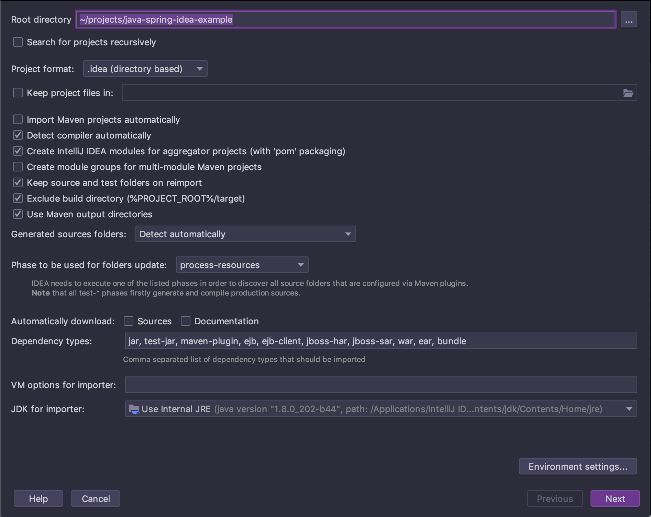
1st Way : Use Spring Initializr Web
Notes:
Lesson descriptions should be brief.

Slide 24
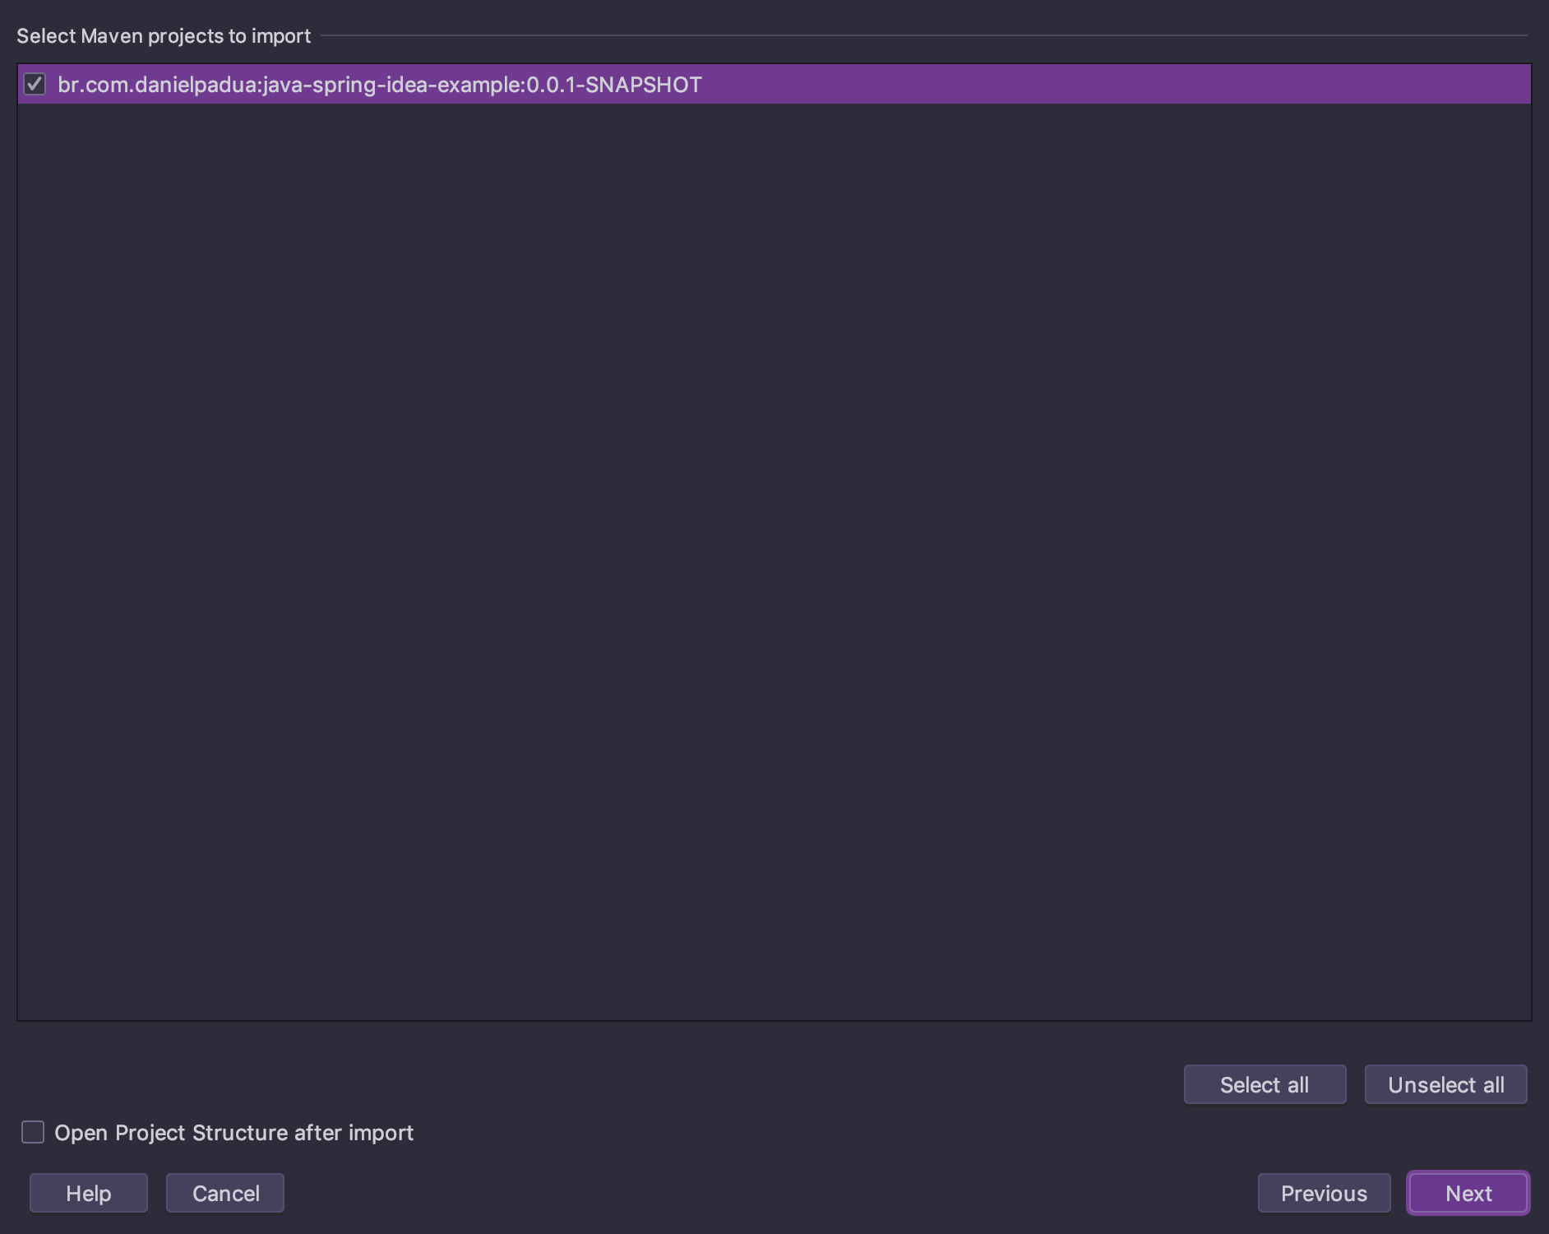
1st Way : Use Spring Initializr Web
Select the project to import and click next:
Notes:
Lesson descriptions should be brief.

Slide 25
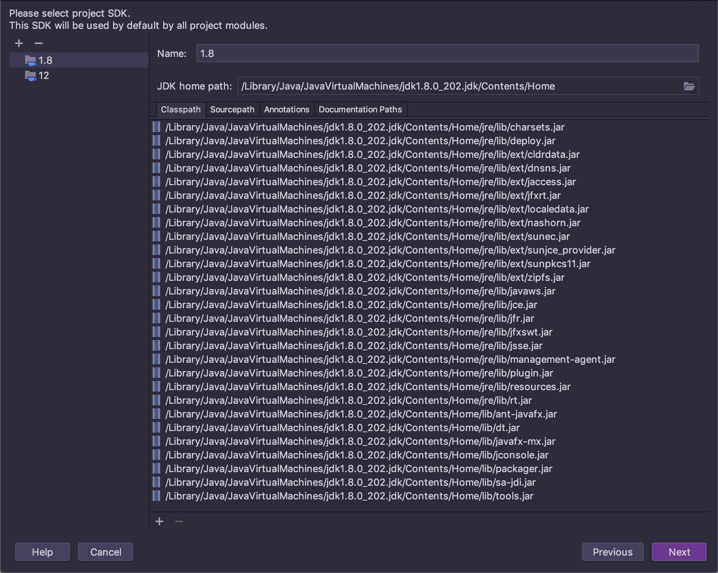
1st Way : Use Spring Initializr Web
In the next screen, set the JDK version that you installed on the Right:
In the next screen confirm the project name and click finish.
Notes:
Lesson descriptions should be brief.

Slide 26
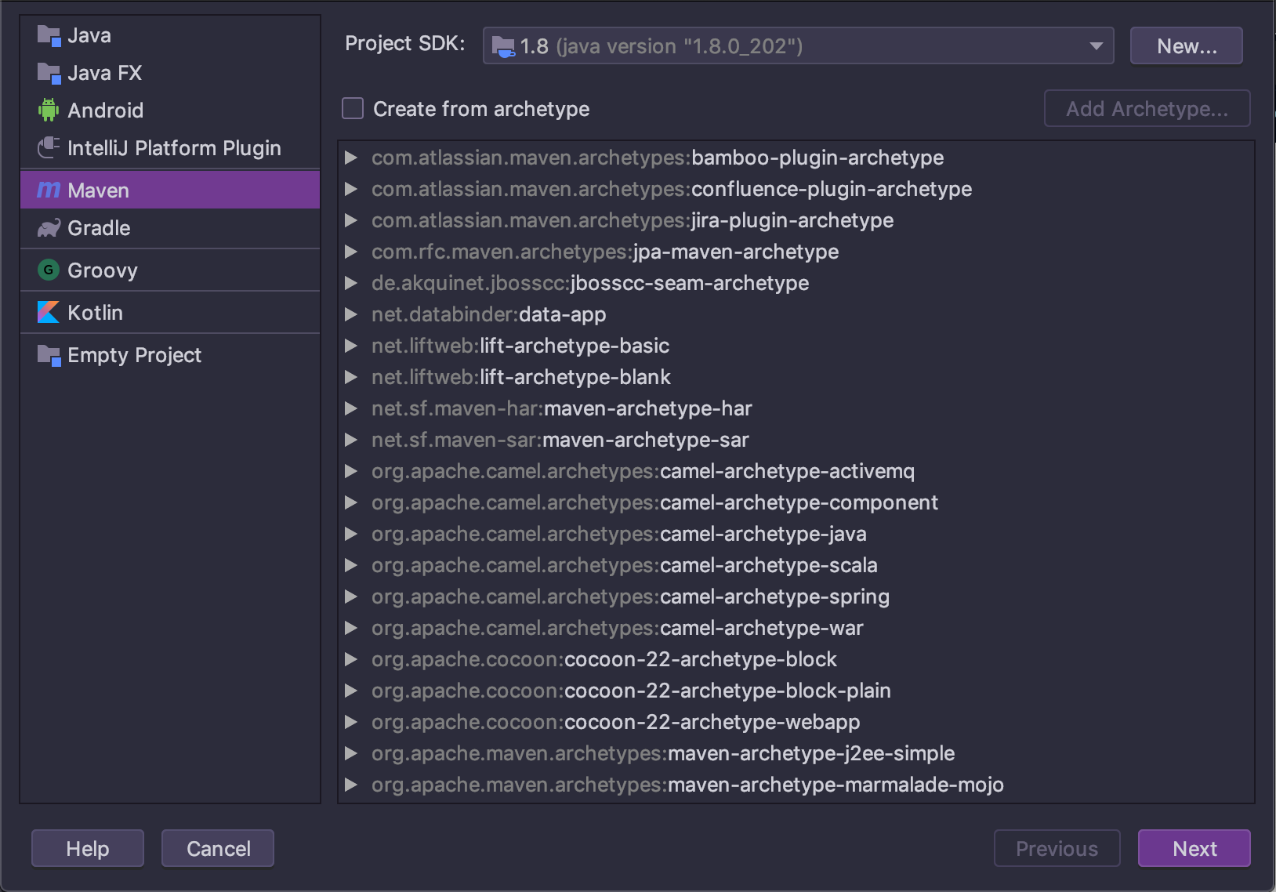
2nd Way : Creating a Maven project and add Spring manually
In IntelliJ IDEA’s initial screen, select Create New Project, located on the left side tab and select Maven, on the right side, select the JDK version and click next:
When selecting the archetype, IntelliJ IDEA will assume that you will use Quickstart archetype, which is ok for our goal.
Notes:
Lesson descriptions should be brief.

Slide 27
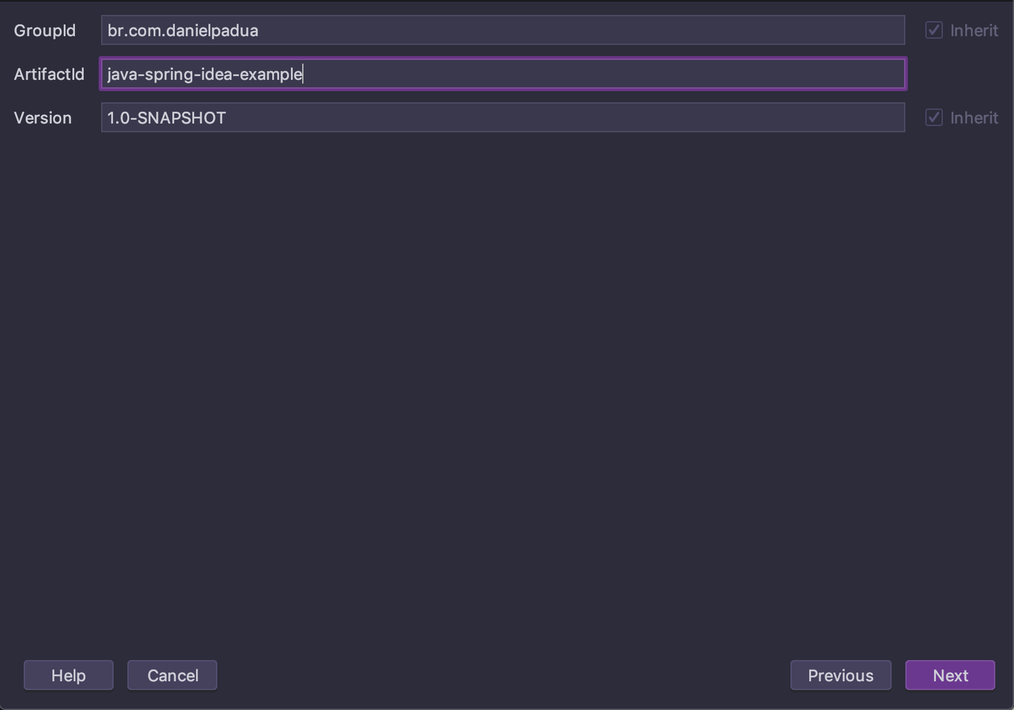
2nd Way : Creating a Maven project and add Spring manually
In the next screen specify the GroupId, ArtifactId and the Version and click next:
Notes:
Lesson descriptions should be brief.

Slide 28
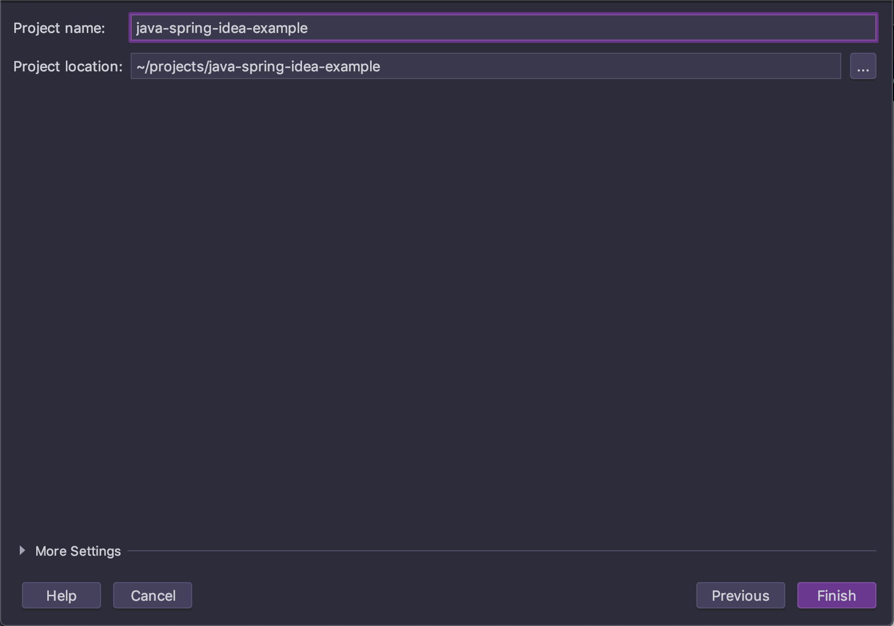
2nd Way : Creating a Maven project and add Spring manually
After you just have to name your project and click finish:
Notes:
Lesson descriptions should be brief.

Slide 29
Creating a Maven project and add Spring manually
With the project created, configure pom.xml according to the following file:
Notes:
Lesson descriptions should be brief.

Slide 30
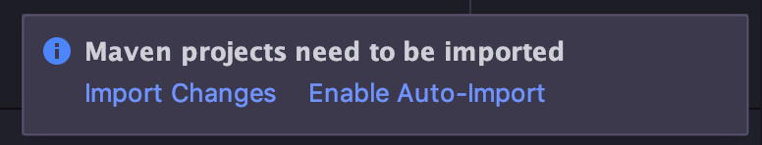
Creating a Maven project and add Spring manually
After you update pom.xml a notification will pop-up at the inferior right side of the screen:
Click Import Changes for Maven refresh all project dependencies.
Notes:
Lesson descriptions should be brief.

Slide 31
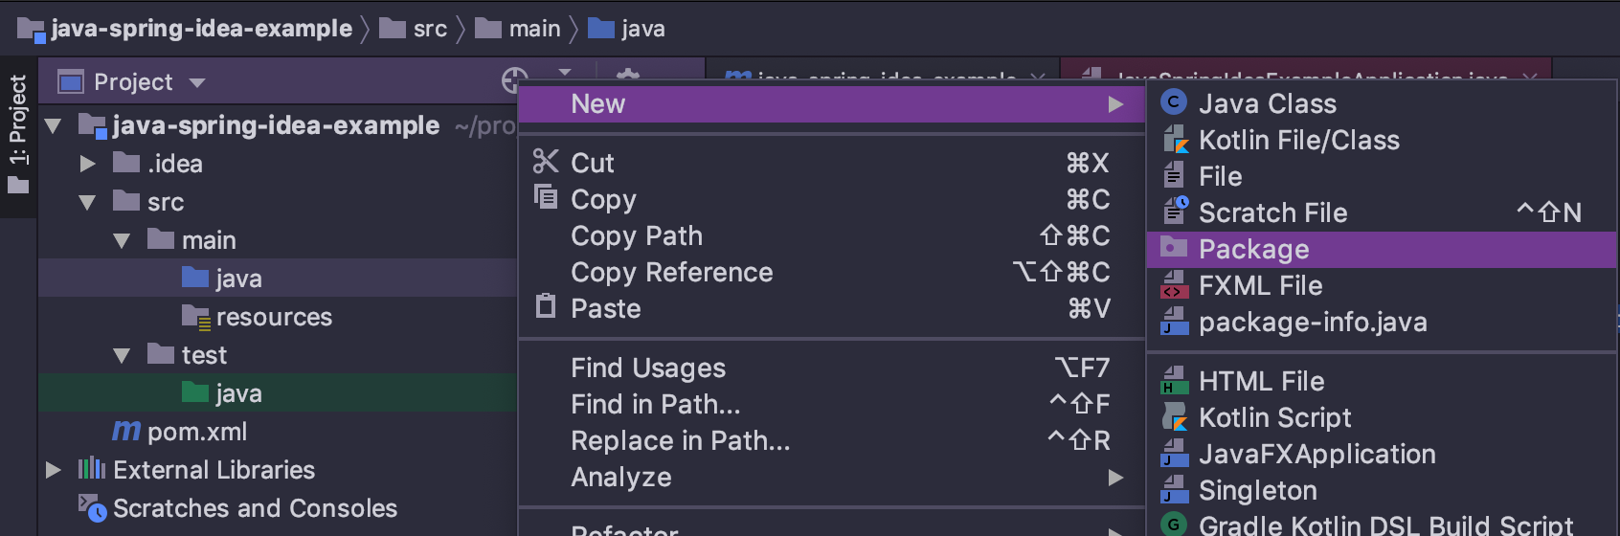
Creating a Maven project and add Spring manually
Now we’ll create a class that will contain the main function of the project.
Remember that creating a class in default package is not a good java practice, so, click in source folder main/java and create a package:
Notes:
Lesson descriptions should be brief.

Slide 32
Creating a Maven project and add Spring manually
Write the name of the package, in the example was:
br.com.danielpadua.java_spring_idea_example
and create a class inside this package named ExampleApplication.java, and write the code:
package br.com.danielpadua.java_spring_idea_example;
import org.springframework.boot.SpringApplication;
import org.springframework.boot.autoconfigure.SpringBootApplication;
@SpringBootApplication
public class ExampleApplication {
public static void main(String[] args) {
SpringApplication.run(ExampleApplication.class, args);
}
}
Notes:
Lesson descriptions should be brief.

Slide 33
Creating a Maven project and add Spring manually
Don’t forget the unit tests main class too, repeat package creation step and create a class named: ExampleApplicationTests.java and write the code:
package br.com.danielpadua.java_spring_idea_example;
import org.junit.Test;
import org.junit.runner.RunWith;
import org.springframework.boot.test.context.SpringBootTest;
import org.springframework.test.context.junit4.SpringRunner;
@RunWith(SpringRunner.class)
@SpringBootTest
public class ExampleApplicationTests {
@Test
public void contextLoads() {
}
}
At this moment we’ll have basically the same project structure that is generated by Spring Initializr at the section above.
Notes:
Lesson descriptions should be brief.

Slide 34
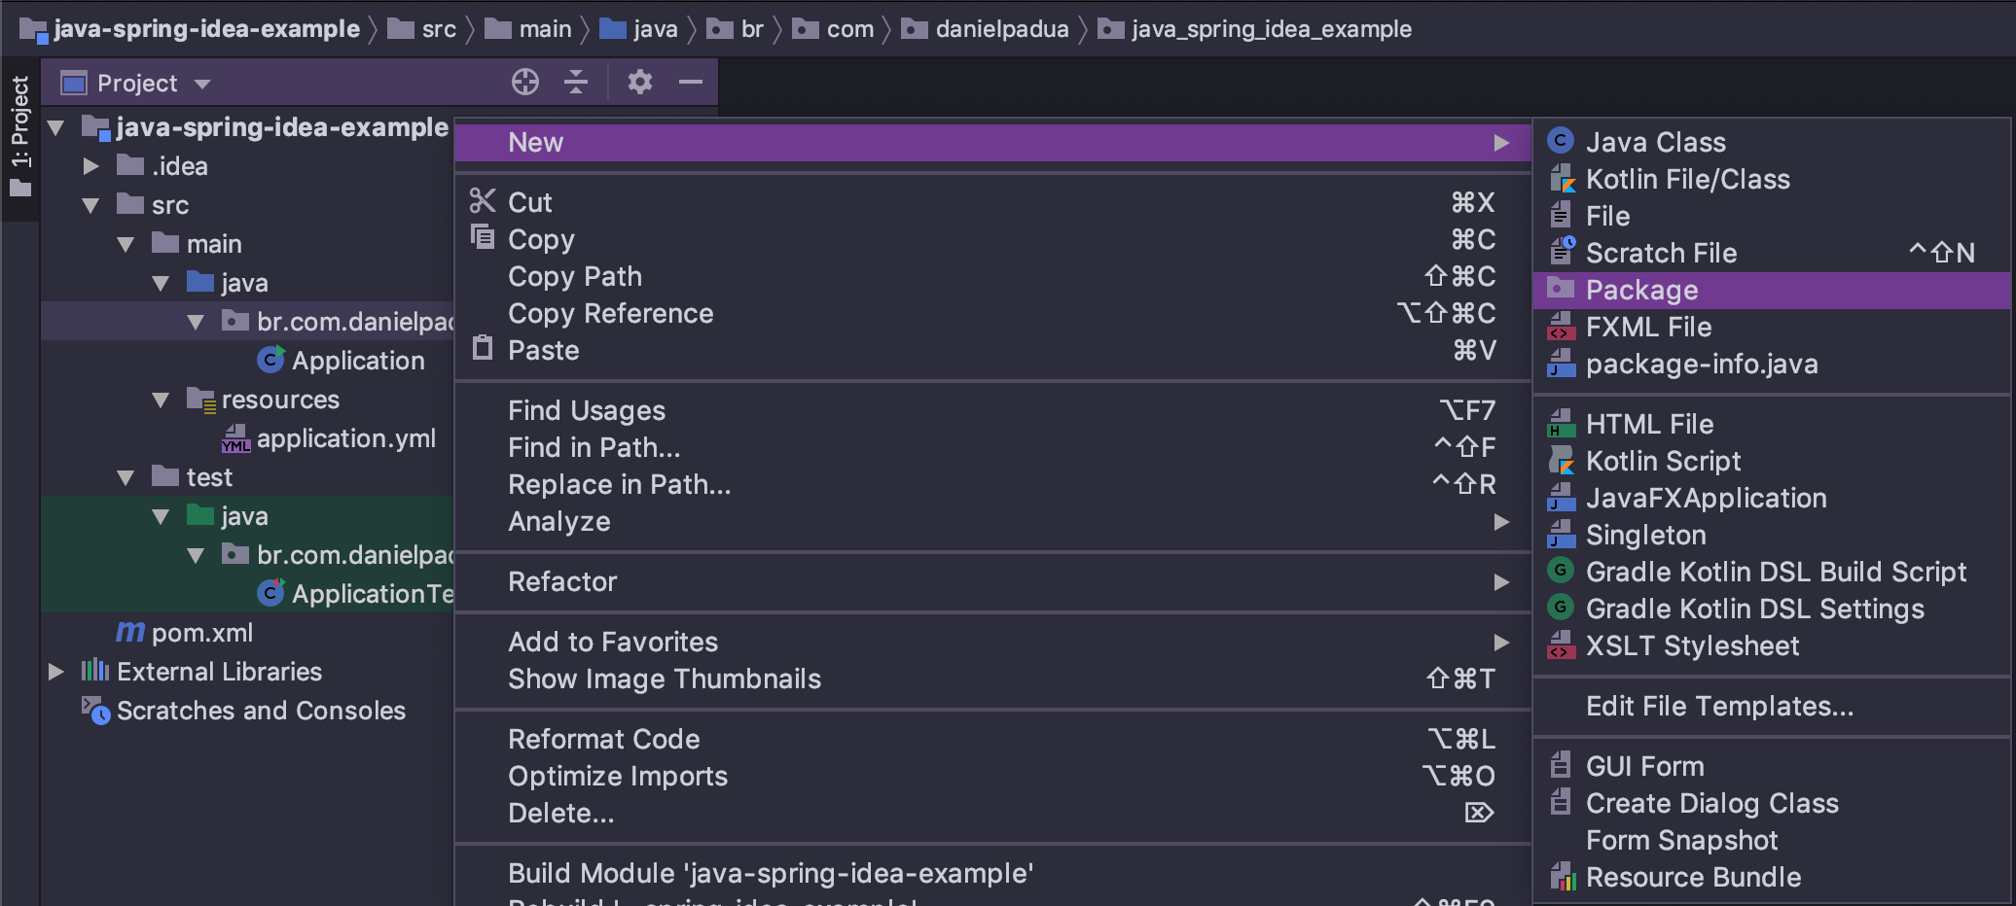
Completing the project
With the basic project skeleton created, we just have to create a package to nest the controller that will contain Hello World endpoint. Right click the root package:
Notes:
Lesson descriptions should be brief.

Slide 35
Completing the project
Write: controllers and confirm. Inside the generated package, create a class named: ExampleController.java and write the code:
package br.com.danielpadua.java_spring_idea_example.controllers;
import org.springframework.http.ResponseEntity;
import org.springframework.web.bind.annotation.GetMapping;
import org.springframework.web.bind.annotation.RequestMapping;
import org.springframework.web.bind.annotation.RestController;
@RestController
@RequestMapping("/api/example")
public class ExampleController {
@GetMapping("/hello-world")
public ResponseEntity<String> get() {
return ResponseEntity.ok("Hello World!");
}
}
Notes:
Lesson descriptions should be brief.

Slide 36
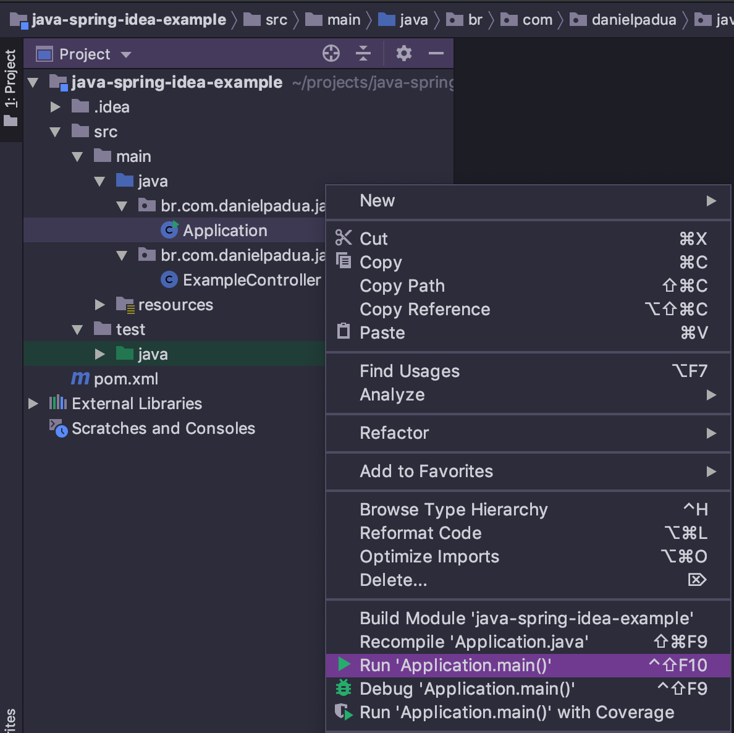
Completing the project
Run the project by right clicking over the main class ExampleApplication.java and select the option Run ‘Application.main()’:
Notes:
Lesson descriptions should be brief.

Slide 37
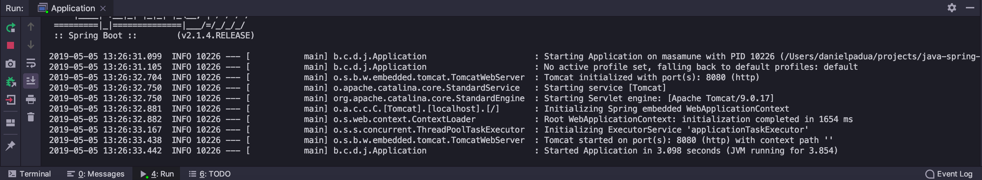
Completing the project
After clicking run, you should see the output in the Run tab located at screen’s bottom:
Notes:
Lesson descriptions should be brief.

Slide 38
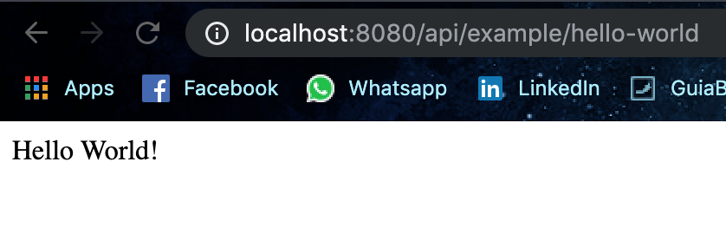
Completing the project
To test the app, you only have to open your favorite browser and access: http://localhost:8080/api/example/hello-world, and you should see the Hello World message:
Notes:
Lesson descriptions should be brief.

Slide 39
SPRING BOOT REST API
Notes:
How presentation will benefit audience: Adult learners are more interested in a subject if they know how or why it is important to them.
Presenter’s level of expertise in the subject: Briefly state your credentials in this area, or explain why participants should listen to you.

Slide 40
Introduction
Spring Boot has REST support by providing default dependencies right out of the box.
Spring Boot provides RestTemplateBuilder that can be used to customize the RestTemplate before calling the REST endpoints.
In this tutorialI we will show how to create and run a simple CRUD REST API project using Spring Boot.
Notes:
Lesson descriptions should be brief.

Slide 41
Prerequisites
IntelliJ IDEA (Community edition)
Spring Boot 1.4.3.RELEASE
Spring 4.3.5.RELEASE
Maven 3.1
JDK 1.8 or More
Postman for Testing
Notes:
Lesson descriptions should be brief.

Slide 42
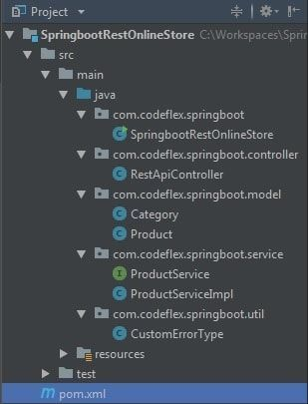
Project Structure
Notes:
Lesson descriptions should be brief.

Slide 43
Project Structure
Our project represents a simple online store that contain products. We want our application to expose REST API’s CRUD principle – create, read, update, and delete.
To Create a product : HTTP POST should be used
To Retrieve a product : HTTP GET should be used
To Update a product : HTTP PUT should be used
To Delete a product : HTTP DELETE should be used
Notes:
Lesson descriptions should be brief.

Slide 44
Project Structure
Usually REST Web services return JSON or XML as response, although it is not limited to these types only.
Clients can specify (using HTTP Accept header) the resource type they are interested in, and server will return the resource.
Any Spring @RestController in a Spring Boot application will render JSON response by default as long as Jackson2 [jackson-databind] is on the class-path.
Notes:
Lesson descriptions should be brief.

Slide 45
Maven Dependency Management (pom.xml)
<project xmlns="http://maven.apache.org/POM/4.0.0" xmlns:xsi="http://www.w3.org/2001/XMLSchema-instance" xsi:schemaLocation="http://maven.apache.org/POM/4.0.0 http://maven.apache.org/xsd/maven-4.0.0.xsd">
<modelVersion>4.0.0</modelVersion>
<groupId>com.codeflex.springboot</groupId>
<artifactId>SpringbootRestOnlineStore</artifactId>
<version>1.0.0</version>
<packaging>jar</packaging>
<name>SpringbootRestOnlineStore</name>
<parent>
<groupId>org.springframework.boot</groupId>
<artifactId>spring-boot-starter-parent</artifactId>
<version>1.4.3.RELEASE</version>
</parent>
<properties>
<java.version>1.8</java.version>
</properties>
<dependencies>
<dependency>
<groupId>org.springframework.boot</groupId>
<artifactId>spring-boot-starter-web</artifactId>
</dependency>
<dependency>
<groupId>com.fasterxml.jackson.dataformat</groupId>
<artifactId>jackson-dataformat-xml</artifactId>
</dependency>
</dependencies>
<build>
<plugins>
<plugin>
<groupId>org.springframework.boot</groupId>
<artifactId>spring-boot-maven-plugin</artifactId>
</plugin>
</plugins>
</build>
</project>
Notes:
Lesson descriptions should be brief.

Slide 46
Main Class
package com.codeflex.springboot;
import org.springframework.boot.SpringApplication;
import org.springframework.boot.autoconfigure.SpringBootApplication;
@SpringBootApplication(scanBasePackages={"com.codeflex.springboot"})
public class SpringbootRestOnlineStore {
public static void main(String[] args) {
SpringApplication.run(SpringbootRestOnlineStore.class, args);
}
}
Notes:
Lesson descriptions should be brief.

Slide 47
REST Controller
These are our REST APIs:
GET request to /api/product/ returns a list of all products
GET request to /api/product/3 returns the product with ID 3
POST request to /api/product/ with a JSON product object in the request’s body will create a new product
PUT request to /api/product/5 with a JSON product object in the request’s body will update the object with ID 5
DELETE request to /api/product/7 deletes the product with ID 7
DELETE request to /api/product/ deletes all the products
Notes:
Lesson descriptions should be brief.

Slide 48
REST Controller
@RestController: Spring 4′s new @RestController annotation annotation eliminates the need of annotating each method with @ResponseBody.
@RequestBody: Indicates that Spring will bind the incoming HTTP request body to that parameter. While doing that, Spring will use HTTP Message converters to convert the HTTP request body into domain object, based on ACCEPT or Content-Type header present in request.
@ResponseBody: Indictaes that Spring will bind the return value to outgoing HTTP response body. While doing that, Spring will use HTTP Message converters to convert the return value to HTTP response body, based on Content-Type present in request HTTP header. As already mentioned, in Spring 4, you may stop using this annotation.
ResponseEntity: Represents the entire HTTP response.
@PathVariable: This annotation indicates that a method parameter should be bound to a URI template variable.
Notes:
Lesson descriptions should be brief.

Slide 49
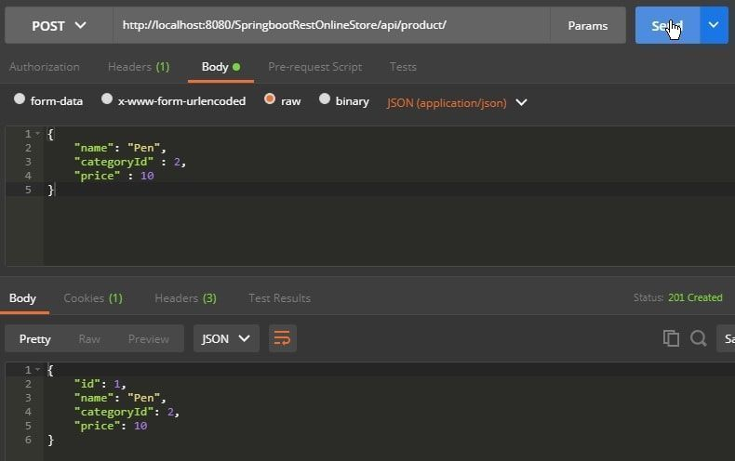
Testing
Let’s run our project and test it via Postman.
Create product (POST)
As you can see we filled our request body with JSON object and after clicking on “Send” we received 201 Status code and the response body with the same object including the ID.
Notes:
Lesson descriptions should be brief.

Slide 50
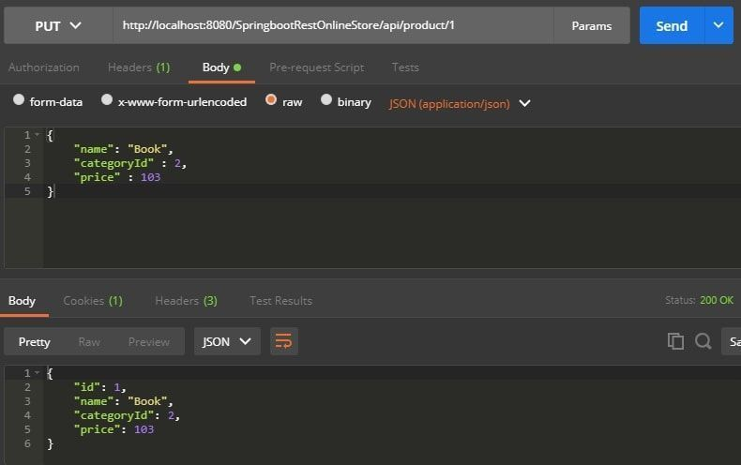
Testing
Update product (PUT)
We updated our pen that we created earlier with another information. It becomes a book now.
Notes:
Lesson descriptions should be brief.

Slide 51
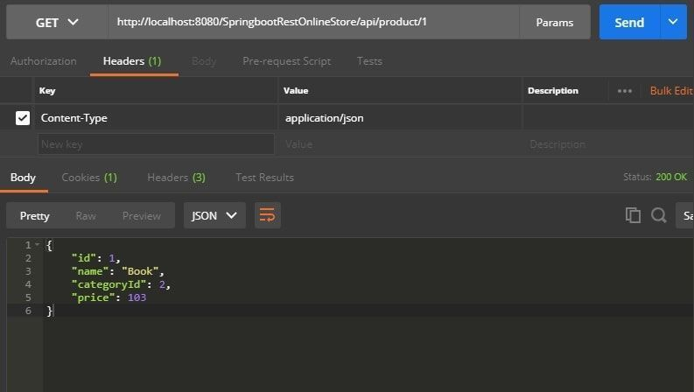
Testing
Get product (GET)
Notes:
Lesson descriptions should be brief.

Slide 52
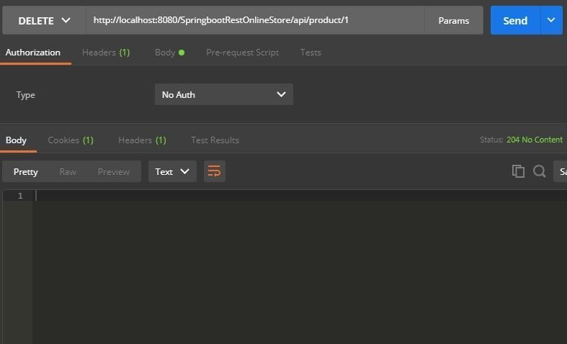
Testing
Delete product (DELETE)
Notes:
Lesson descriptions should be brief.

Slide 53


